Slide 1








We aspire to be the LEADING PROVIDERS of INNOVATIVE AND IMPACTFUL SOLUTIONS that solve diverse and complex problems in the DIGITAL PAYMENTS and FINANCIAL SERVICES Sectors the World Over.
Open Card Management System
Issue & Manage Cards

Slide 2


Content
Paysys Open CMS
01
Open Card Management
System Overview
02
OpenCMS Functionalities
03
OpenCMS Demo
04
OpenCMS Case Studies

Slide 3
CARD MANAGEMENT SYSTEM OVERVIEW & FUNCTIONALITIES

Slide 4

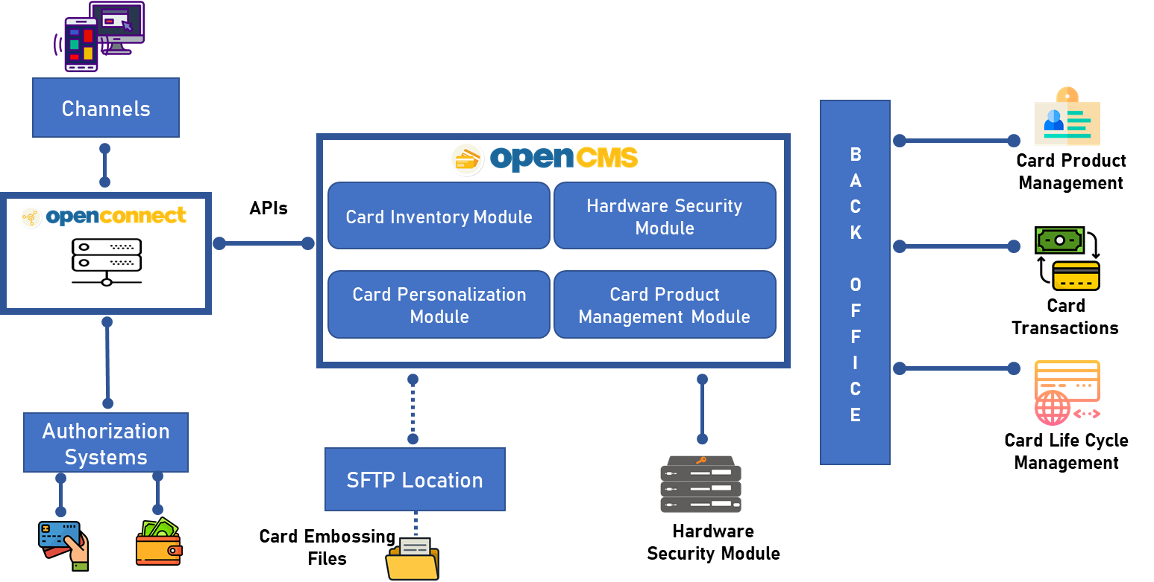


Card Management System
Open CMS Overview
Easily issue both debit and prepaid cards with EMV Contactless, Contact Chip, and magnetic-stripe capabilities. Whether bulk or individual issuance, our intuitive UI streamlines the process.
Just add client details, and their personalized card is good to go!
Hosted
Flexible
Our Card Management System is offered as a hosted service
Can be easily integrated with authorization systems (Core Banking Systems, CRM etc.) via APIs

Slide 5
















Card Management System
Card Management System Functionalities
ACS 3DS
Notification/Alert
Scheme Gateway
Card Customization
Card & Pin
Authentication
Card Life Cycle
Management
titanium
Debit
Card Control,
Fee & Limit Mgmt
2205 4701 5900 8843
Monitoring Dashboard
& Reporting
VALID
FROM
11/23
UNTIL
END
11/28
ADEEL IQBAL
Product Definition
& Handles all Txn
(Full ACS, Partial ACS and No ACS)
Corporate
Management
Point/Fund Transfer
& Top Up
EMV Certified

Slide 6
CARD MANAGEMENT SYSTEM DEMO

Slide 7

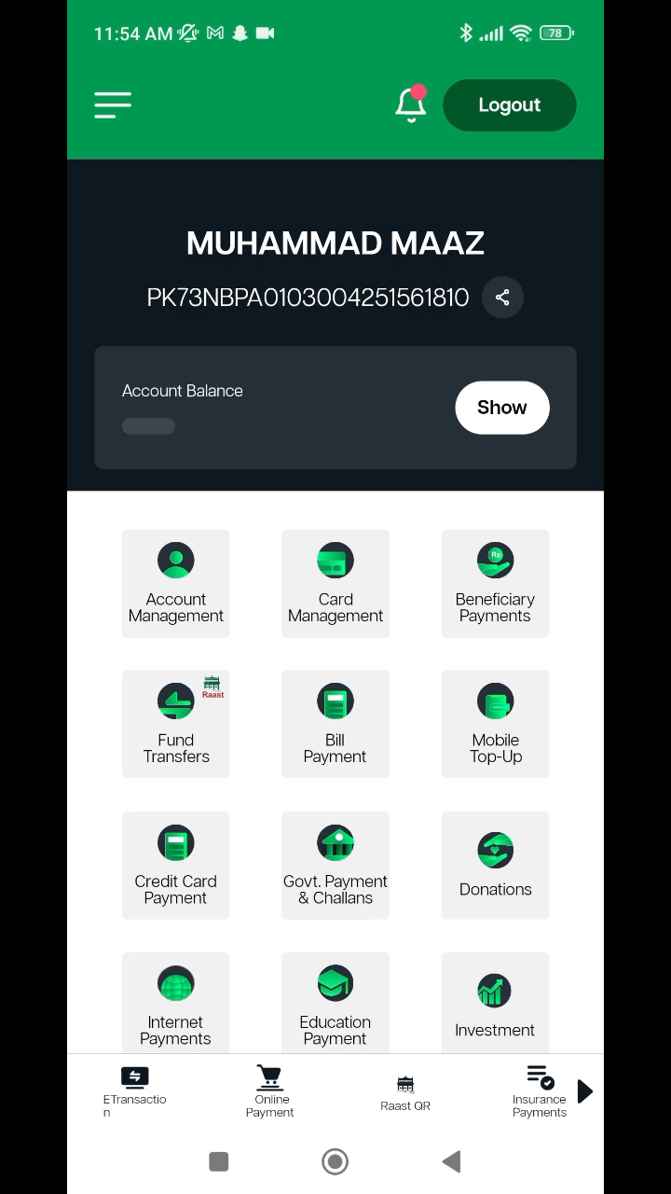
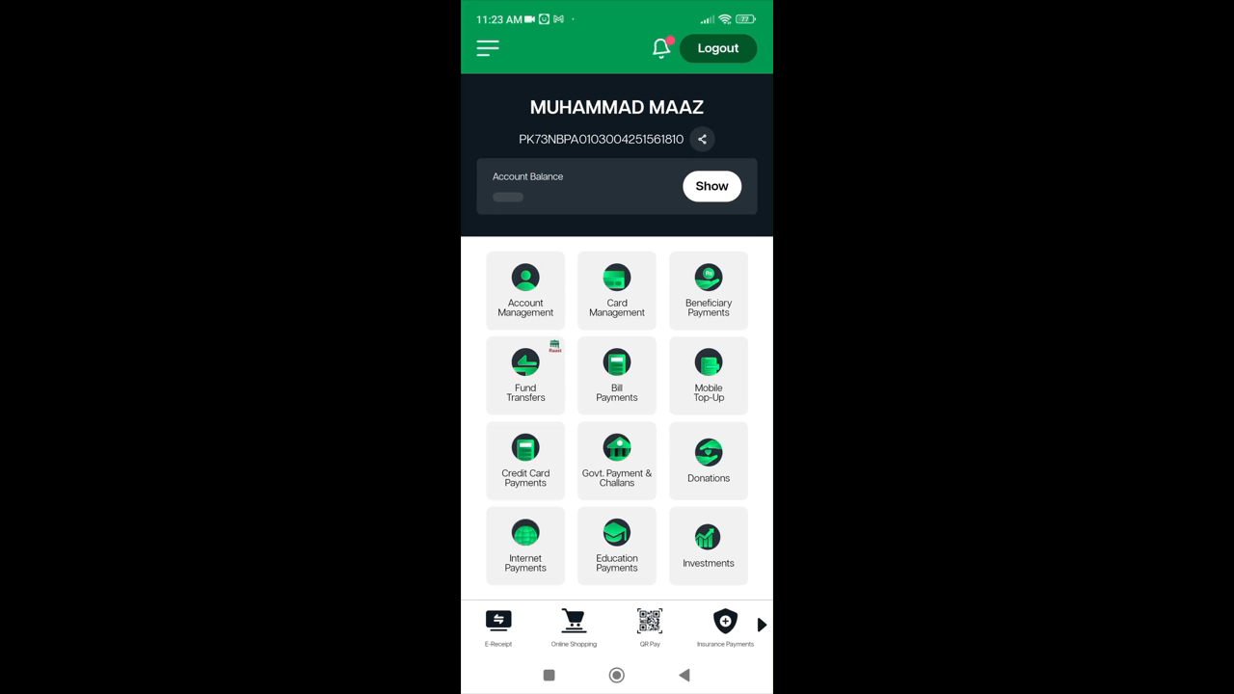
Card Management System
Card Management System Demo
Create Debit Card
Experience the simplicity of generating a debit card within the app:
Generate PIN code
Enabling secure online transactions
Instantly.
Debit Card Management
Effortlessly manage your debit card with features like:
Activate/Deactivate
Viewing card details
Enable/Disable online transactions Update card limits
PIN Management

Slide 8
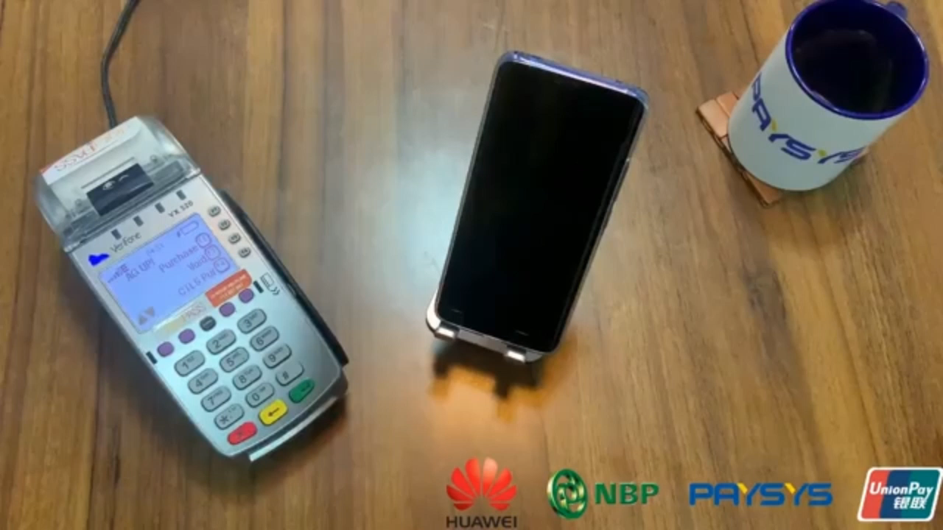
CARD MANAGEMENT SYSTEM
HCE/Tokenization Demo
HCE/Tokenization
Simplified Transactions: Tap smartphone for payments.
Enhanced Security: Replace card details with unique tokens.
Convenience: Seamless payments with smartphones.
Compatibility: Widely adopted across POS terminals.
Future-Proof: Adaptable to evolving technology trends.

Slide 9
CARD MANAGEMENT SYSTEM BACK OFFICE

Slide 10

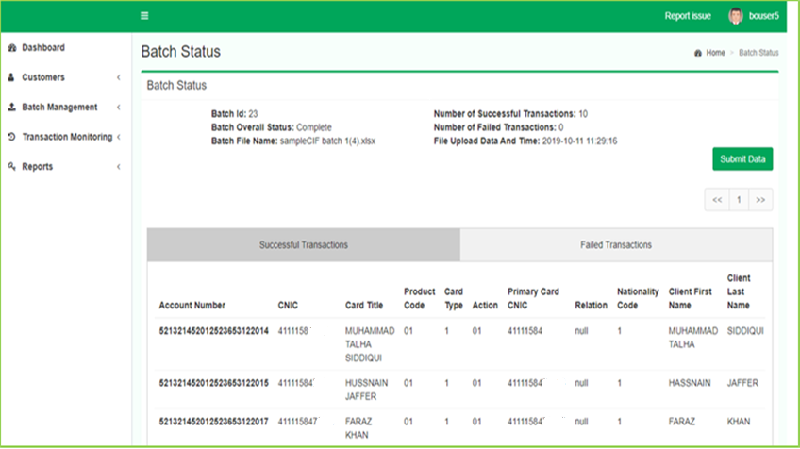
CARD MANAGEMENT SYSTEM
Card Life Cycle Management – Upload Batch
CMS User will select “Upload File/Batch”
CMS User will select Batch File, On submission successful records request will be forward to checker for approval of card generation

Slide 11
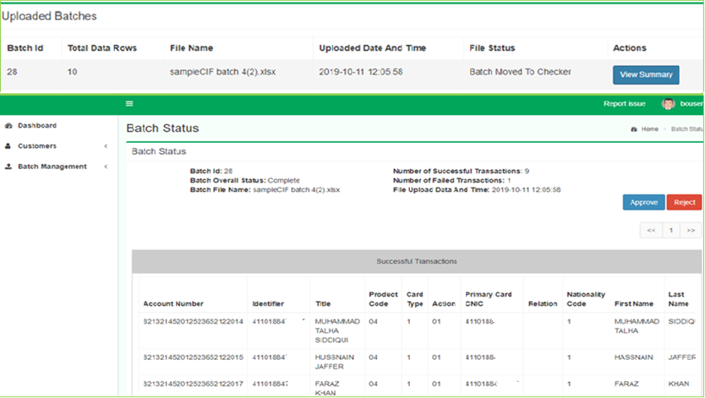
CARD MANAGEMENT SYSTEM
Card Life Cycle Management – Upload Batch
Checker will select any of record with status “Approval Pending” and click on “View Summary” Button.
Checker review records and have following options:
Approved/Reject.
On approval, system will a start a job and start generating card embossing file for selected batch.

Slide 12
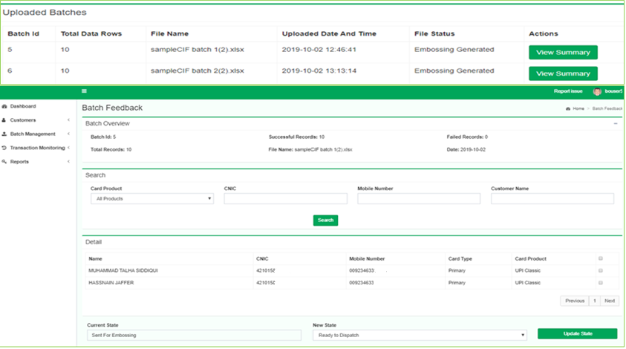
CARD MANAGEMENT SYSTEM
Card Life Cycle Management – Upload Batch
User can select batch file with status “Embossing generated”.
In Batch Feedback Screen, User can choose Select:
Filtered records
Single record
All records.
After selecting records, they can choose from the following options:
Ready to dispatch
Failed to emboss

Slide 13
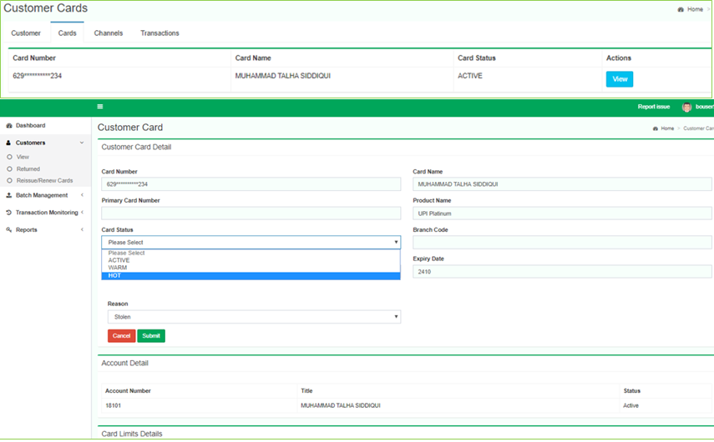
CARD MANAGEMENT SYSTEM
Card Life Cycle Management – Upload Batch
User can view customer card details
User can change the following:
Customer card details.
Card status.
Card Limit .

